Slide 1
Print Advertising
Climate Change and Sustainability
Instructions:
Below are a selection of advertisements. They have been designed to advertise sustainability, climate change or both. You may need to research the company each advertisement has been produced by to understand their purpose.
Your task is to select ONE of these advertisements for your Advertisement Analysis Task.

Slide 2


Slide 3
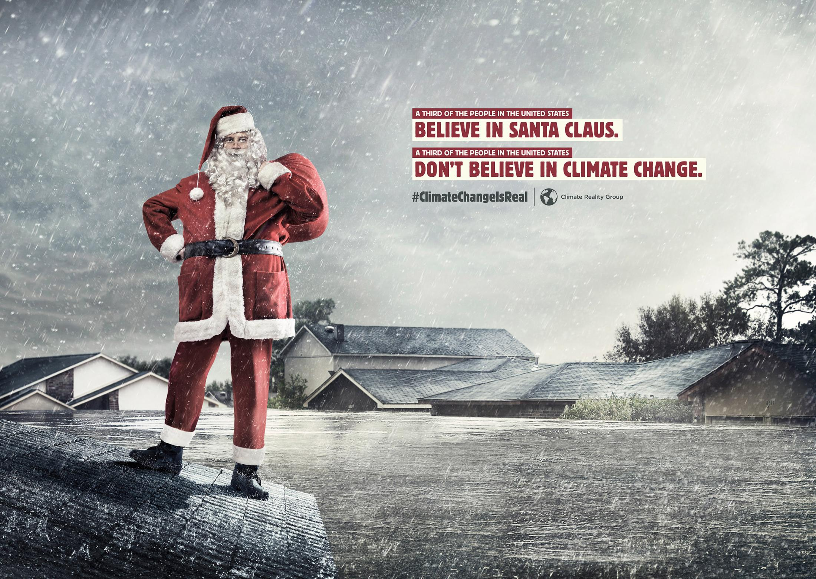

Slide 4
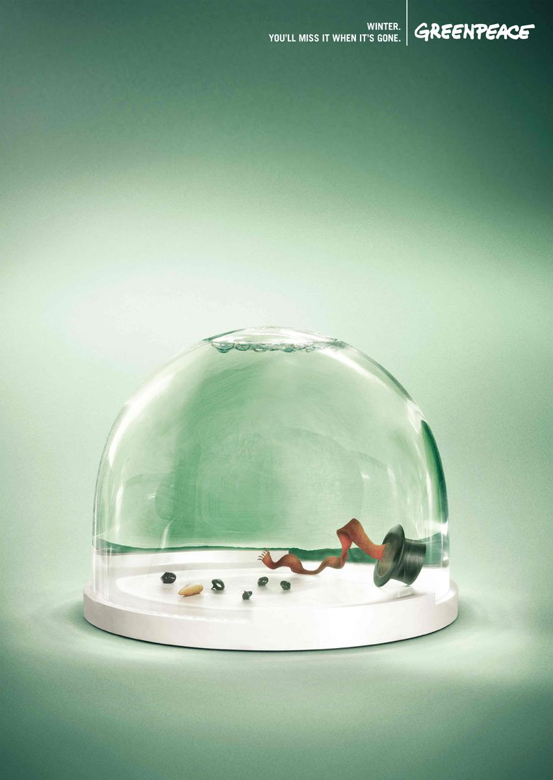

Slide 5
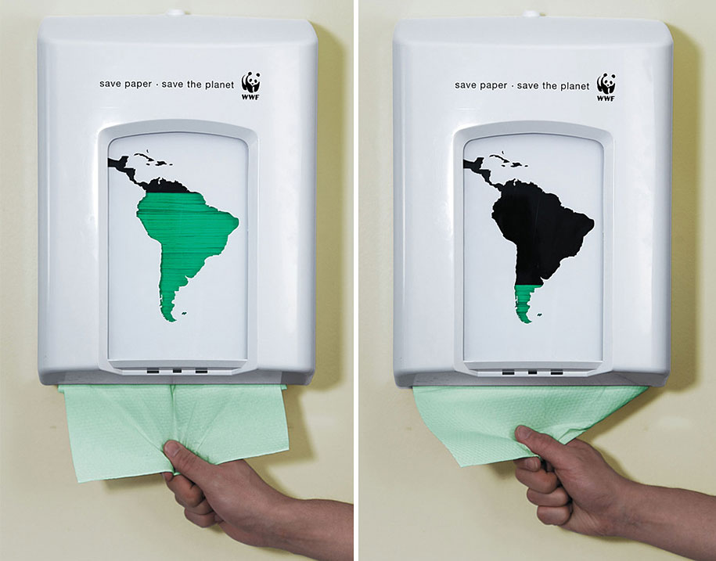

Slide 6
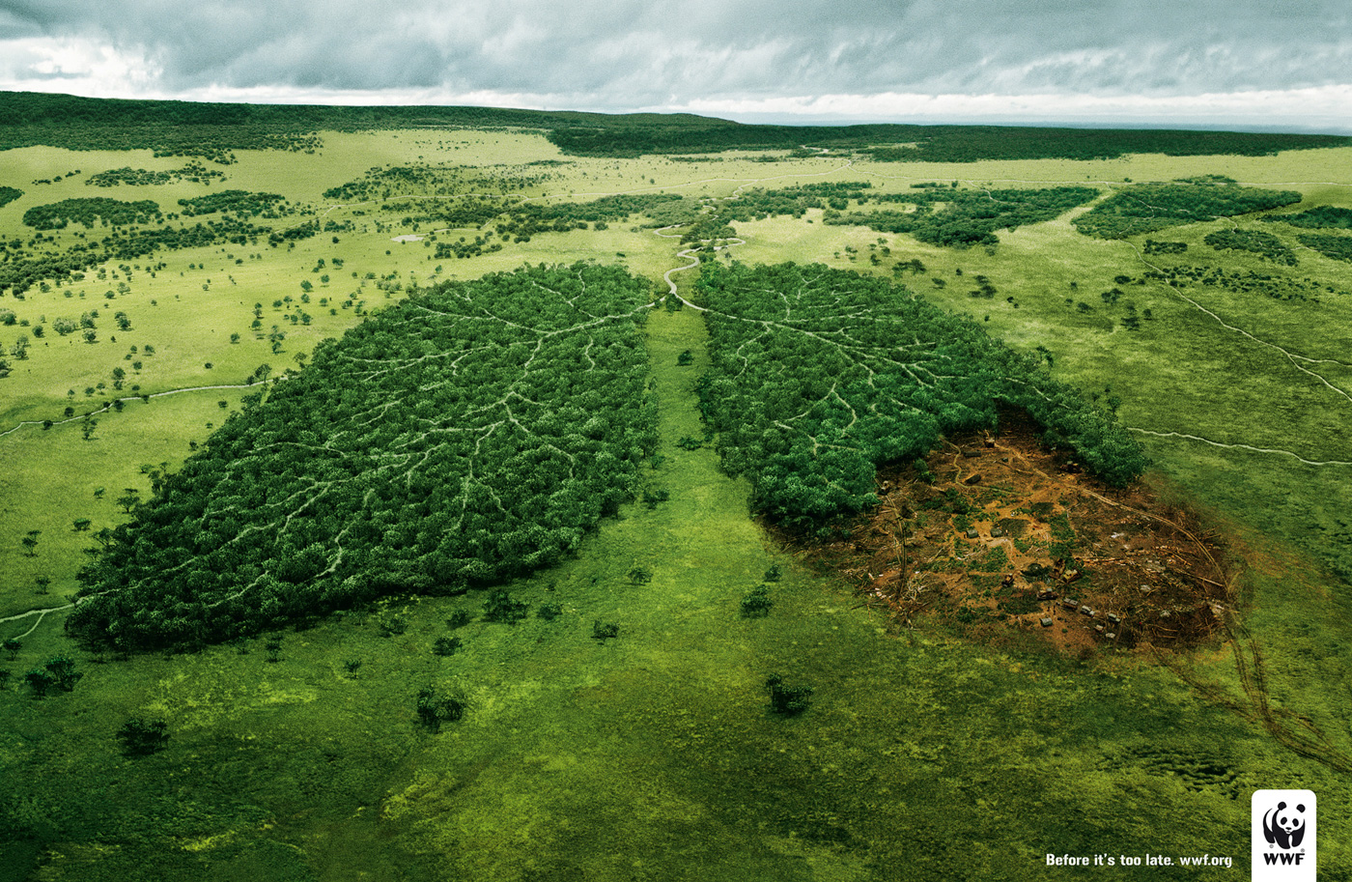

Slide 7
